Slide 1
Docker
Liu Su
December 15, 2018

Slide 2
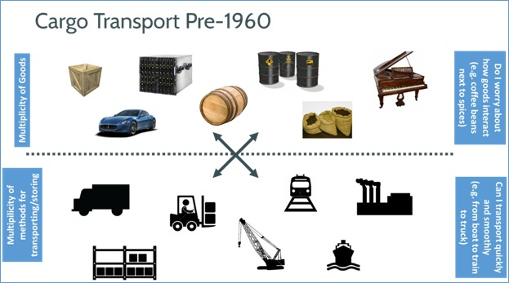
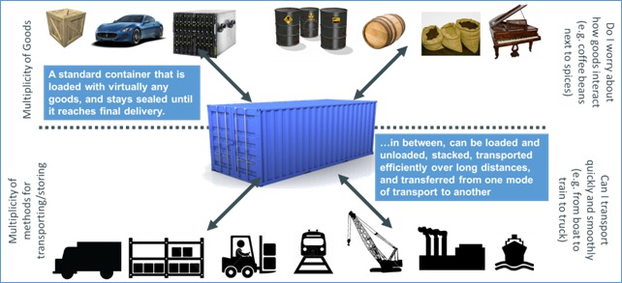
Imaging...
Using containers is the modern solution for cargo transport

Slide 3
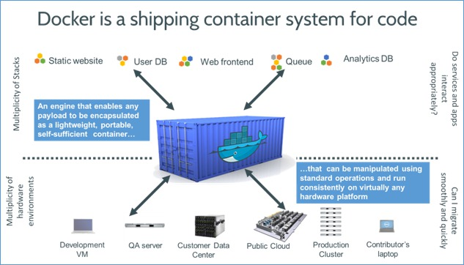
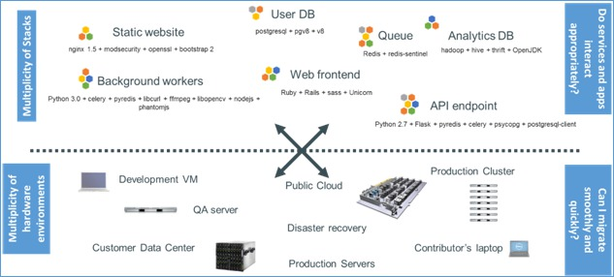
Similar challenge in software
Using “containers” is the modern solution for “code transport/deployment”
PODA: package once, deploy anywhere

Slide 4
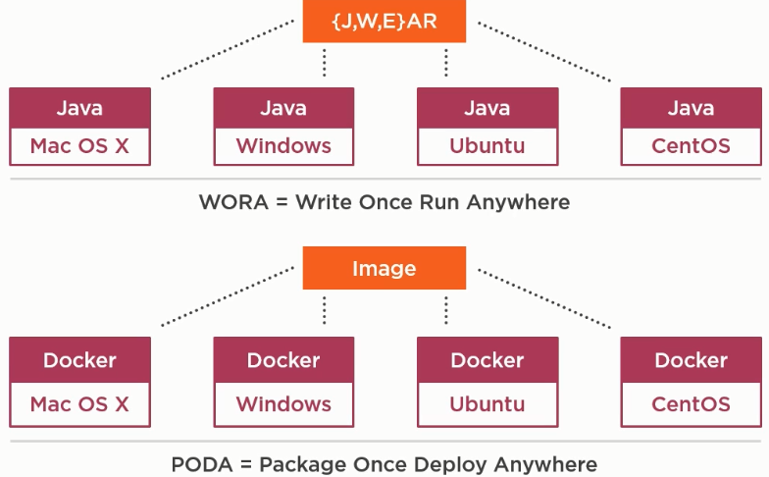
PODA and WORA

Slide 5
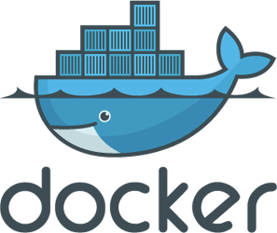
What is Docker
Platform for building, storing, running, and managing containers at scale
Useful for deploying distributed applications and setting up local dev environments
Great for maximizing resource utilization in production servers

Slide 6
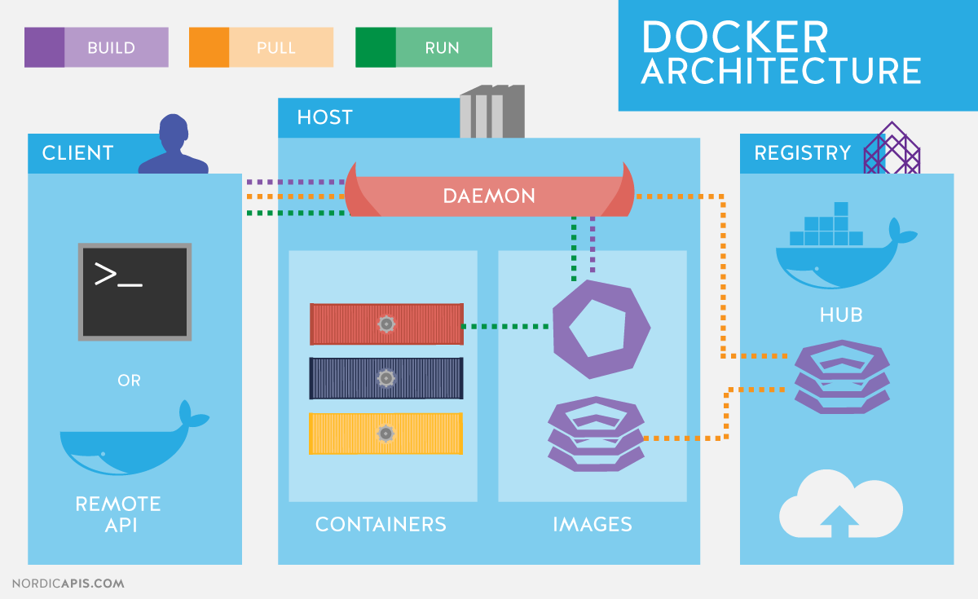
How it works
Notes:
Docker Daemon:

Slide 7
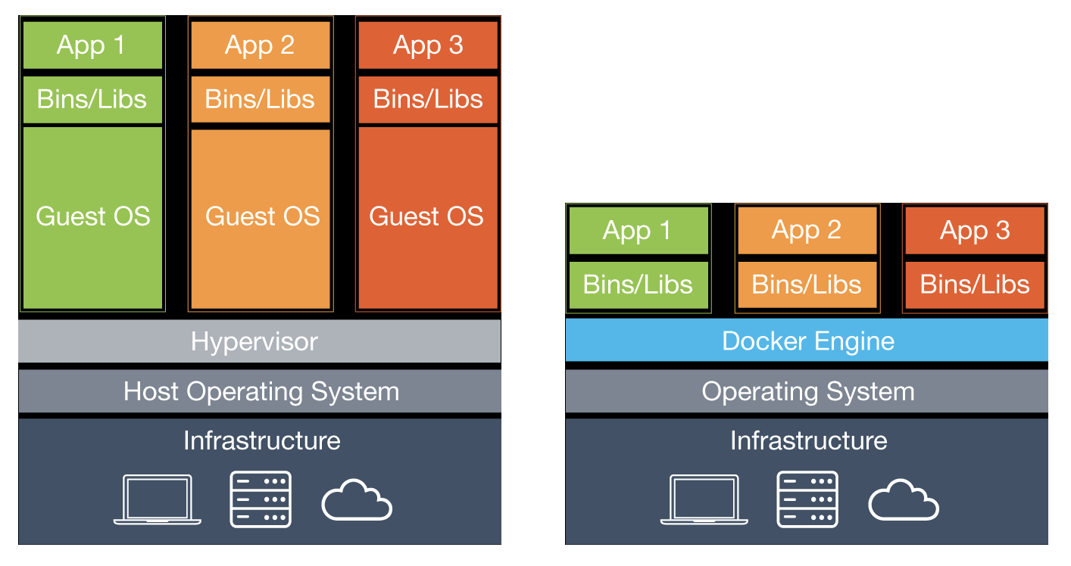
Container manager, not VM manager
Everything runs on the kernel of the host OS
Uses namespaces and cgroups to isolate, secure, and manage the containers and their resources
Much lighter on the host OS due to not having to replicate the kernel
Can be used along with VMs to run distributed systems at scale
VM
(heavy-weight with extra layers of overhead)
Docker
(light-weight)
Notes:
Type 2 hypervisor: hypervisors run on a host operating system that provides virtualization services, such as I/O device support and memory management.

Slide 8
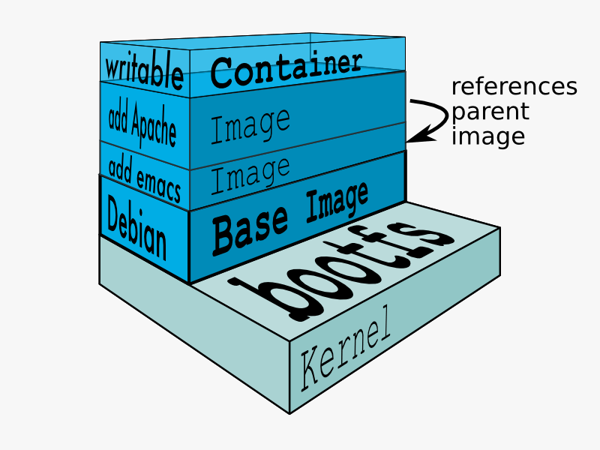
Layers, Images, and Containers
Layers are snapshots of the file-system at different steps in creating an image.
An image is a combination of multiple layers which merged together to describe a container environment.
A container is a running instance of an image.

Slide 9
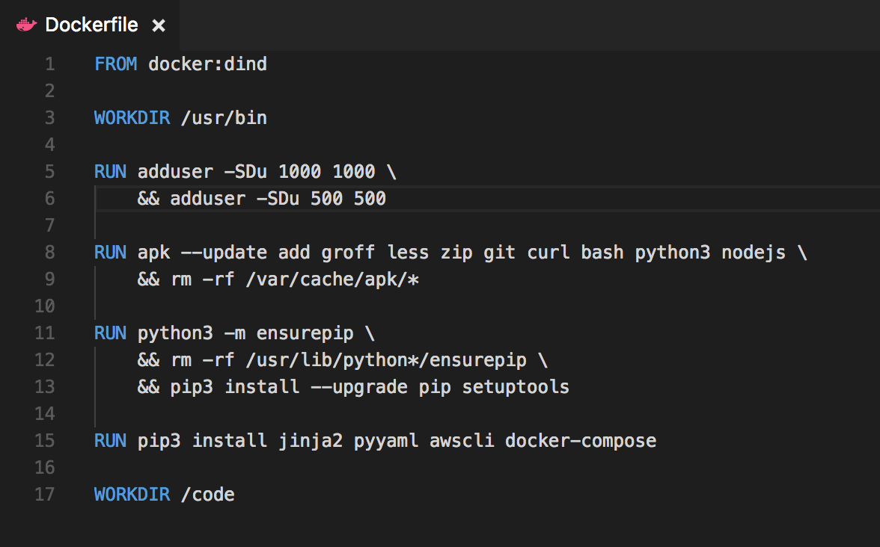
Dockerfile
Used for creating images
Describe the steps to create the filesystem you want your code to be running in
Commands available: FROM, RUN, WORKDIR, CMD, EXPOSE, ENV, COPY, etc.

Slide 10
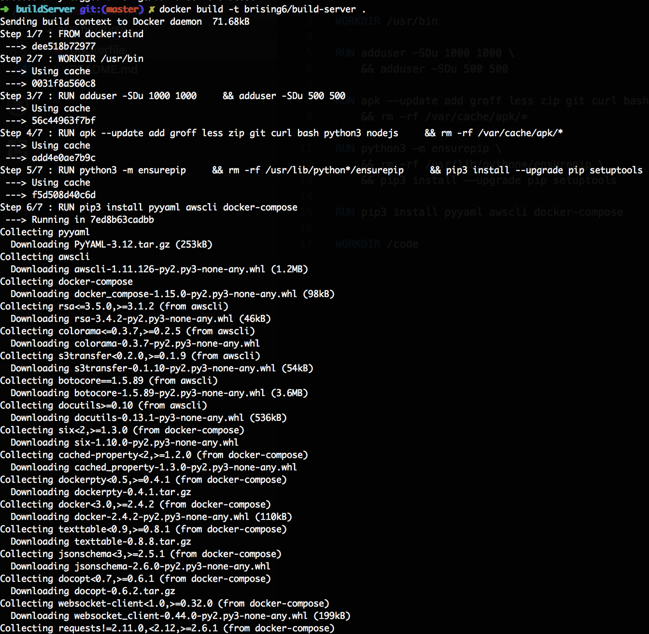
Building images
Searches for Dockerfile in directory provided, or uses dockerfile provided
Creates layers based on commands in Dockerfile, and then bundles them into an image
Normally from here you’d push the image to an external repository like dockerhub or artifactory

Slide 11
Running Containers
Describe processes you’d like to run on the filesystem (like apps)
You can also share volumes with the container to inject files when running the container, and you can define localhost ports to map ports in the container
You can also do many more specific alterations to your runtime environment

Slide 12
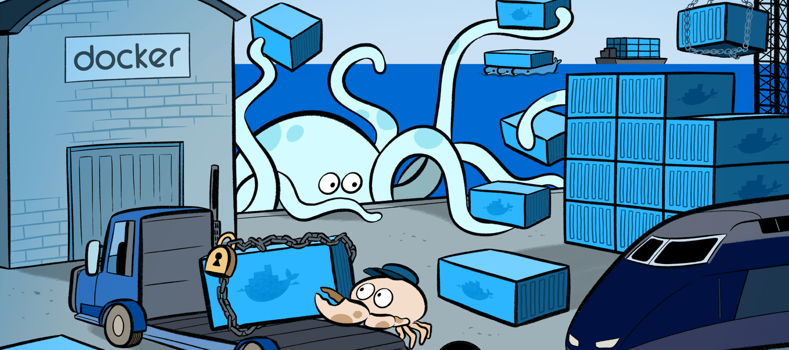
Docker-Compose
Basically a docker run orchestration tool
Makes it easy to share volumes between, link, and run containers together
Allows you to put your run configurations in source control
Has options for orchestrating image builds as well

Slide 13
Demo
Hello-world
Show basic docker functionality: search, pull, run, snapshot new image, push
Dockerfile
Docker-compose

Slide 14
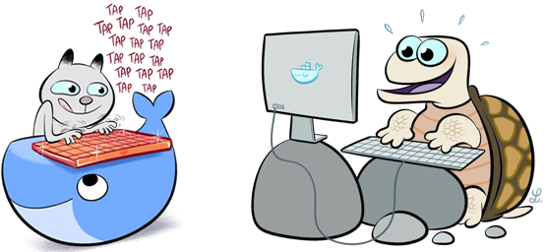
Questions?

Slide 15
Helpful links and acknowledgements
The docker doc: https://docs.docker.com/
A docker workshop: http://neependra.net/docker/rootconfWorkshop.html
Brandon Rising

Slide 16
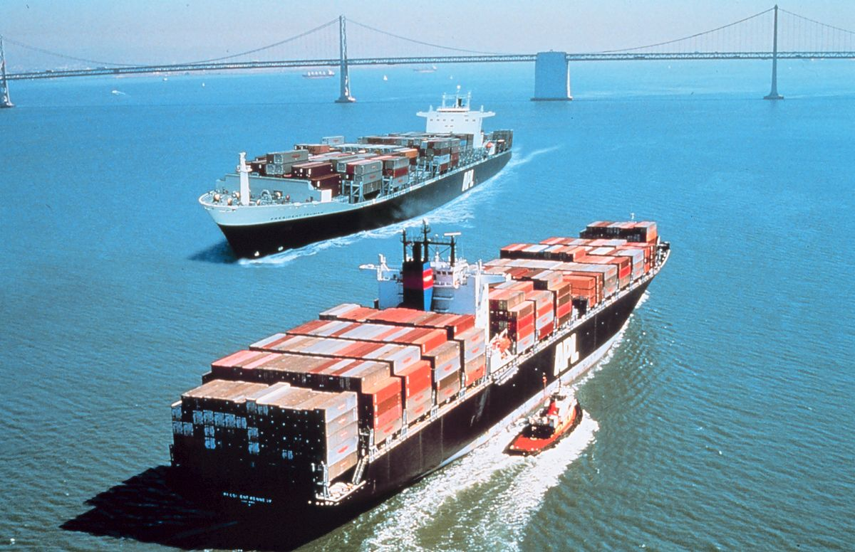
Networking between containers
By default, creates a network interface named bridge for the containers to communicate with each other on
Linking a container adds the container’s ID and name to your container’s /etc/hosts file to simplify communication between containerized applications

Slide 17
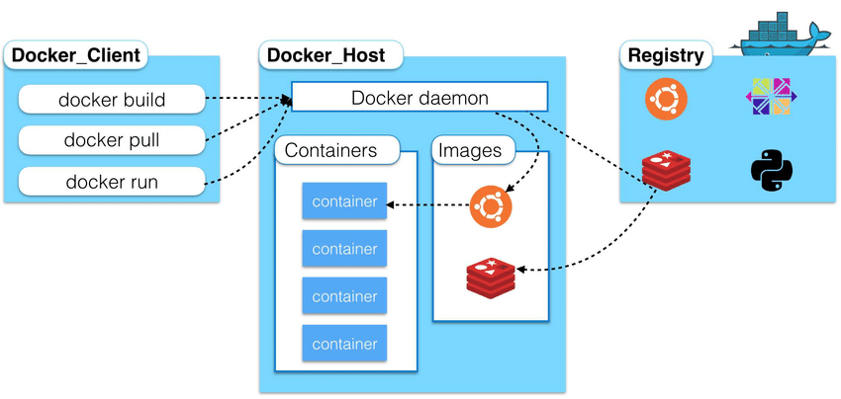
Introduction (extra)

Slide 18
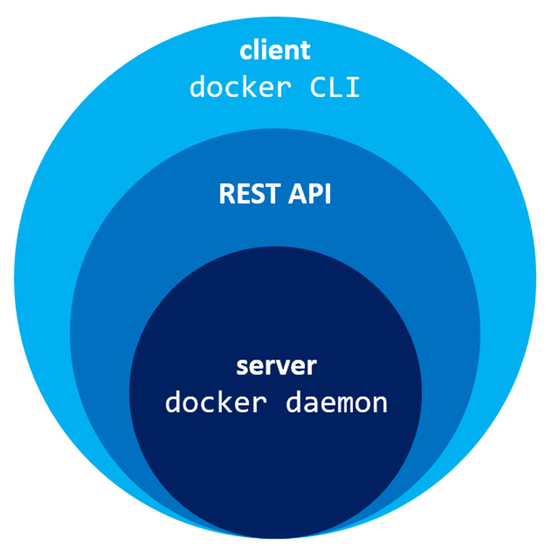
Introduction (extra)
Notes:
Docker Daemon: is a service that runs on your host operating system.

